Slide 1
Class of 2025
Important Dates to Keep on Your Radar
Notes:
JM

Slide 2
Get Your Prom Tickets
$40 per person
Tickets are purchased in Mrs. Mathews room before school and Mrs. Evers room after school
Event Information:
Location: RV Hall of Fame
Date: May 10th , 2025
Time: 8:00pm – 11:00pm
Guest forms must be completed at the time of purchasing a ticket.
Notes:
JM

Slide 3
Orders
Did you receive your cap and gown?
Remaining orders may be picked up in the guidance office when you’ve paid your balance.
Please check to make sure you received everything that you ordered.
Cash or Money Order (NO Checks)
Notes:
JM

Slide 4
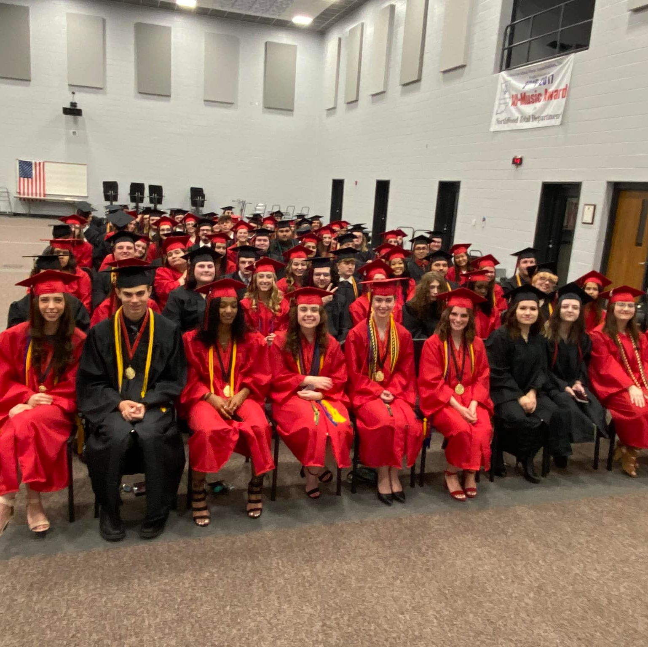
Cap and Gown
Check Length
Should hit midcalf
Be sure your skirt/dress hem doesn’t hang out of the gown.
Place on Hanger NOW!
If you’re borrowing from a friend, get the gown and cap now and check size.
Girls wear red; boys were black. Let Ms. Mast know if you are switching colors.
You must have the regular tassel with the ‘25. These are $11 in guidance.
Any preapproved cords may be worn for graduation. (ex. FFA, FCCLA)
Check your email to see if you qualify for Dual Credit Cords, you will be able to pick these up in the guidance office for $10
Notes:
JM

Slide 5
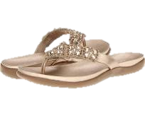
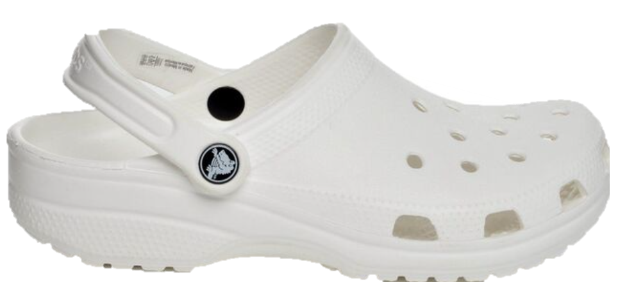
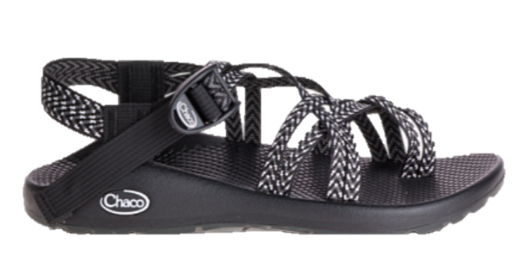
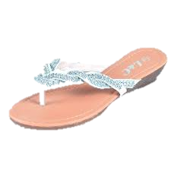
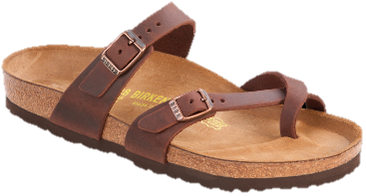
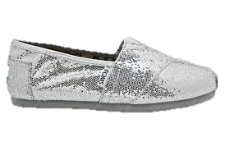
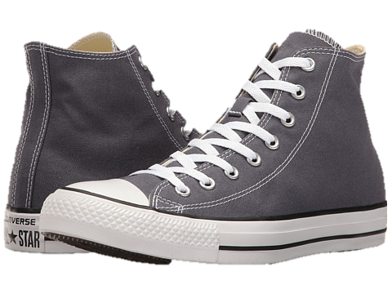
Dress Requirements (Formal) - Women
Dress/Skirt (Sleeveless is fine)
Dress slacks
Dress Shoes (With back or straps). Be sure you can walk well in them.
NO rompers, dress shorts, strapless, jeans, colored jeans, tennis shoes, flip-flops, sandals without a back, or canvas shoes
See Handout
Notes:
JM

Slide 6
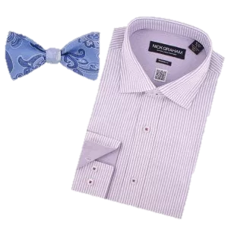
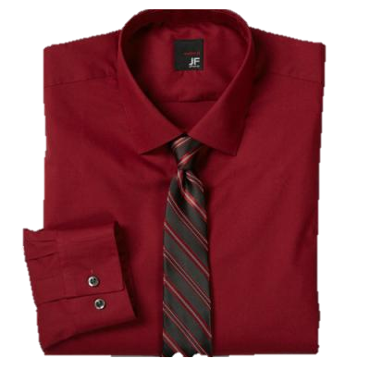
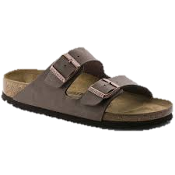
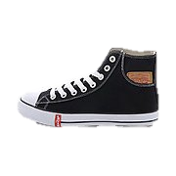
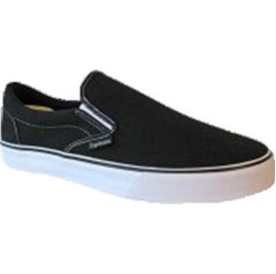
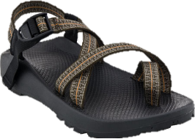
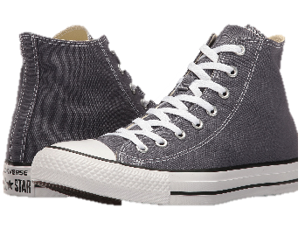
Dress Requirements (Formal) - Gentlemen
Dress Slacks
Shirt with a collar
Tie (Regular or bow)
Dress Socks
Dress Shoes
NO – Shorts, jeans, colored jeans, polo shirts, tennis shoes, flip-flops, or canvas shoes
See Handout
Notes:
EP
Formal attire like that of a wedding
Very important that you wear dress shoes!!
We want to be aware if you need help finding clothes
Your graduation outfit can also be a good graduation gift from a member of your family

Slide 7
Formal Pictures
Photographers will be present before graduation to take professional headshots of students in their caps and gowns.
You will be able to buy these pictures and more after the graduation ceremony!
Notes:
EP
Taking the picture is free, if you would like copies after the ceremony

Slide 8
Commencement Speakers
Try outs are Thursday, May 8th
2:45 P.M.
Mrs. Koble’s Room (806)
You must email Mrs. Koble if you plan to audition.
Bring a printed Manuscript of your speech
Notes:
EP

Slide 9
NorthWood Scholarship Foundation Ceremony
Sunday, April 27th at 1:30 P.M.
NWHS Auditorium—Sitting in auditorium
Students will receive an invitation if receiving a scholarship. RSVP required.
Formal Event—dress requirements apply
Notes:
EP

Slide 10
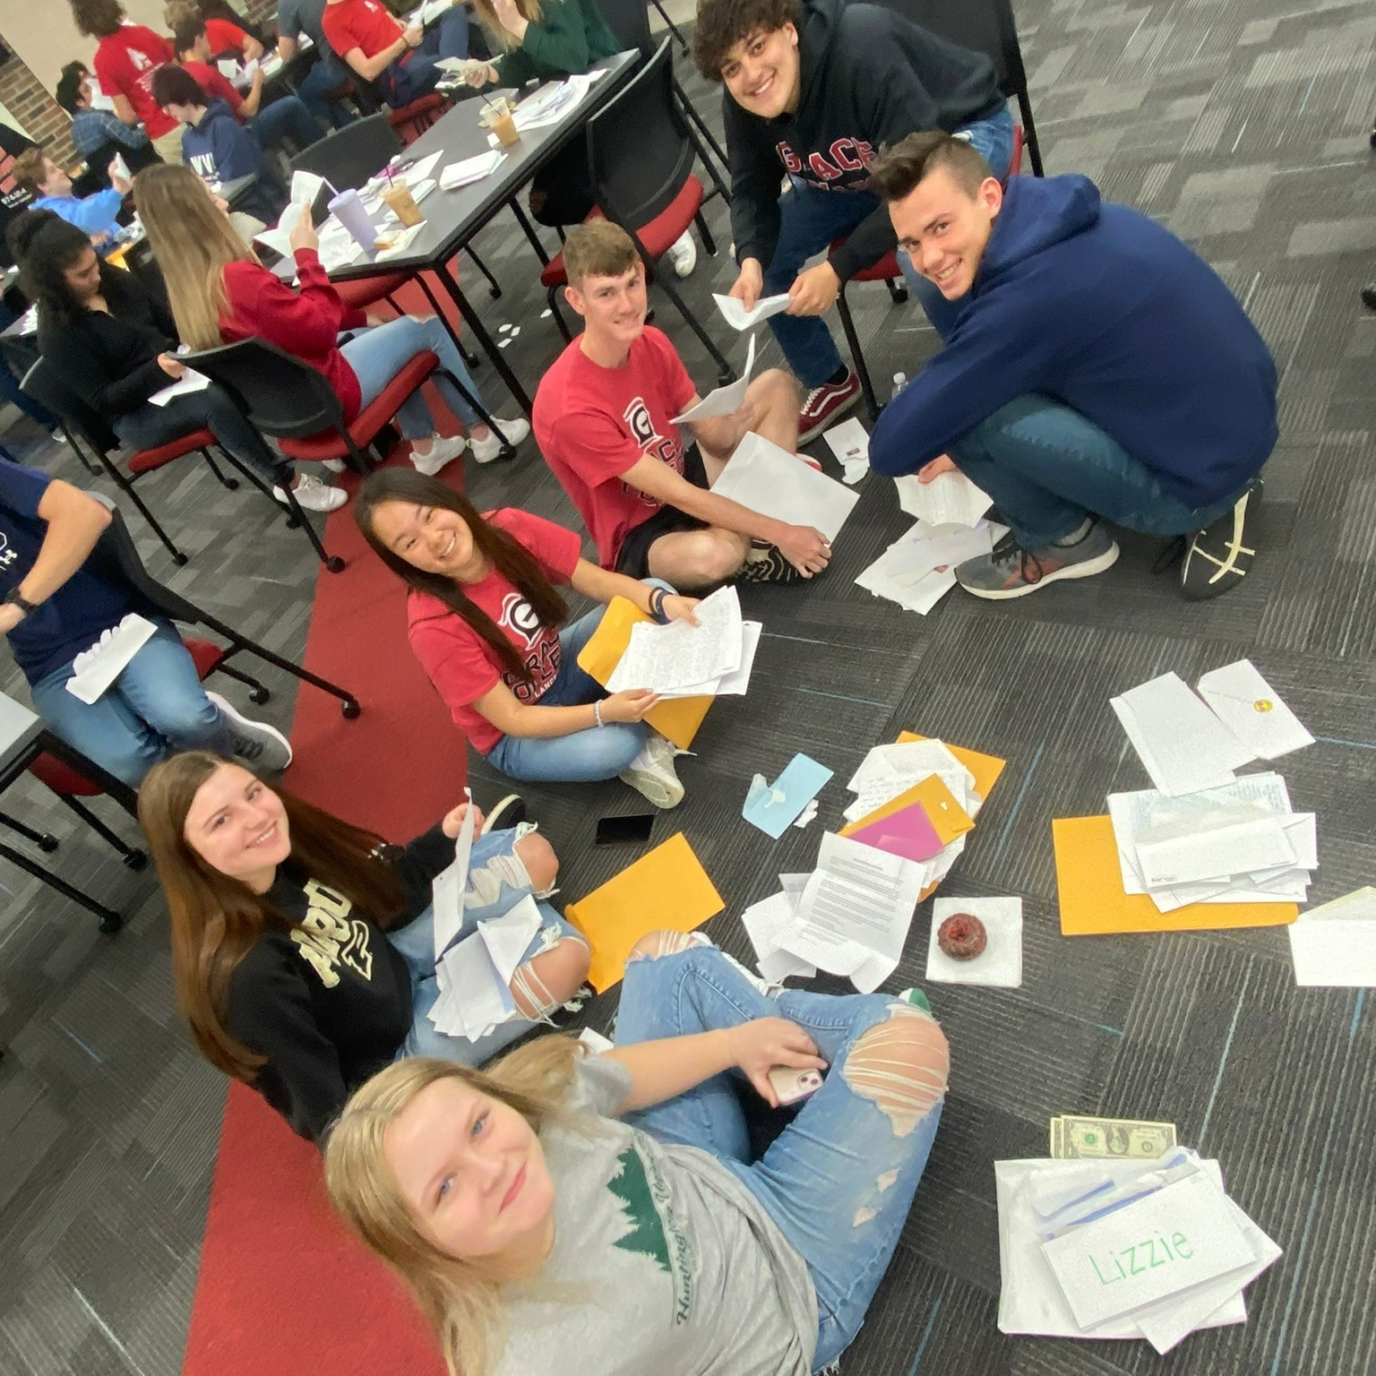
Senior Commitment Day
Tuesday, May 20th, 7:45am – 9:00am
Wear your college/career/military t-shirt (for next year) with jeans/shorts
Pick up a doughnut and your Letter to Myself from 8th grade in the Media Center
We will take group pictures of people going to the same place or doing the same thing
Any LTM not picked up will be in guidance
If you come to school late, go to the Media Center to have your picture taken!
Notes:
JM

Slide 11
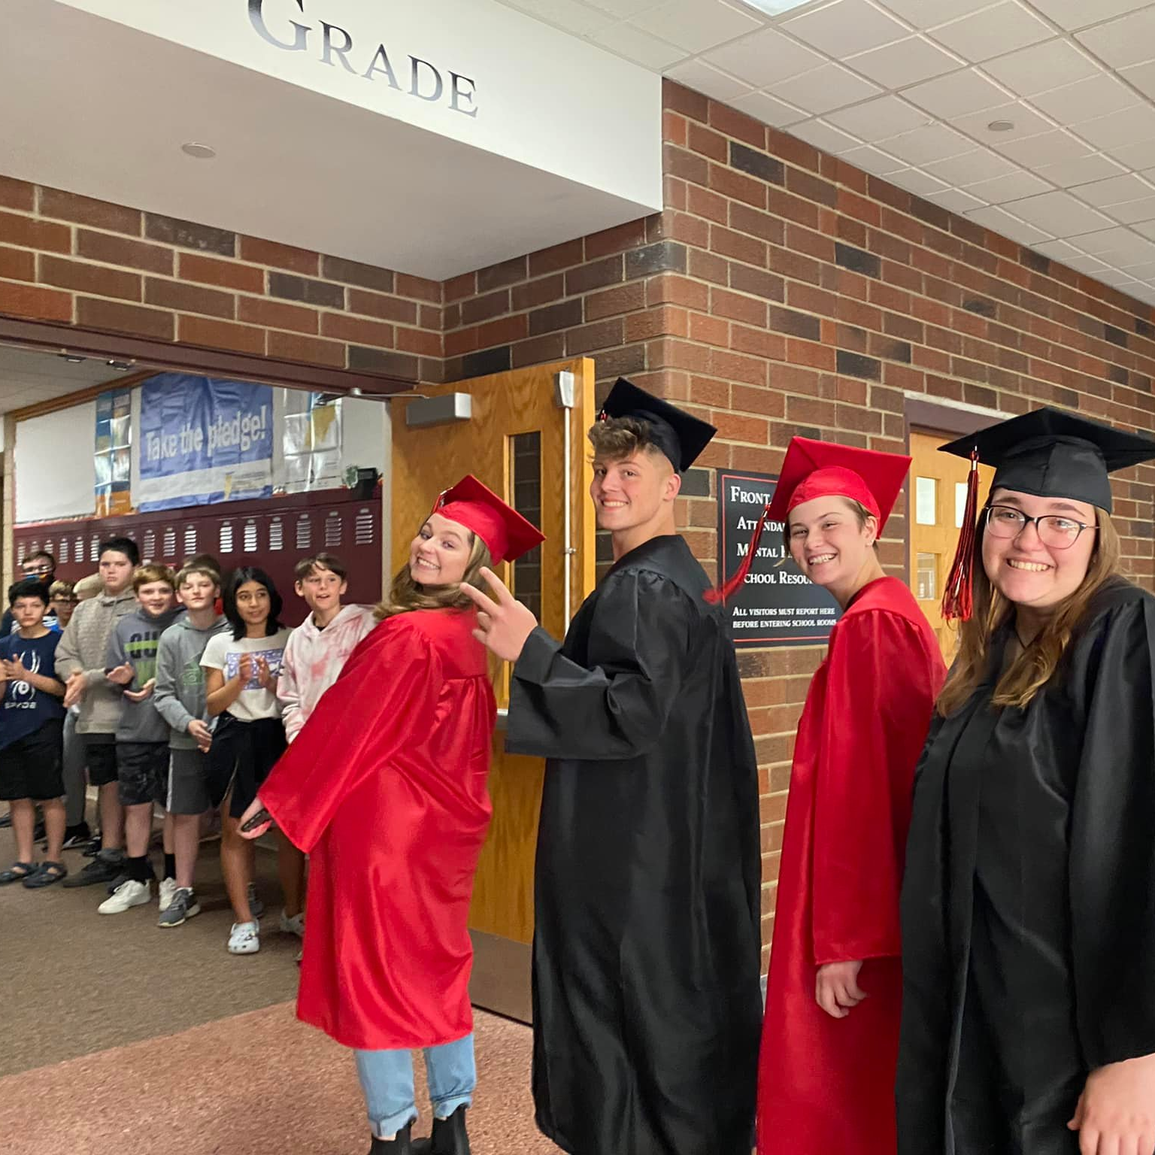
Senior Walk-Through
May 22nd – During School
Bring your cap, gown, and comfy walking shoes
Walk through all the elementary schools and see your old teachers!
A great time to feel like a celebrity as everyone cheers for you!
Notes:
JM

Slide 12
Final Exams
Tuesday, May 27th (2 &4)
Wednesday, May 28th (1,3,&5)
Graduation Applications due Wednesday, May 28th, by 3:00PM in the Guidance Office
Notes:
JM

Slide 13
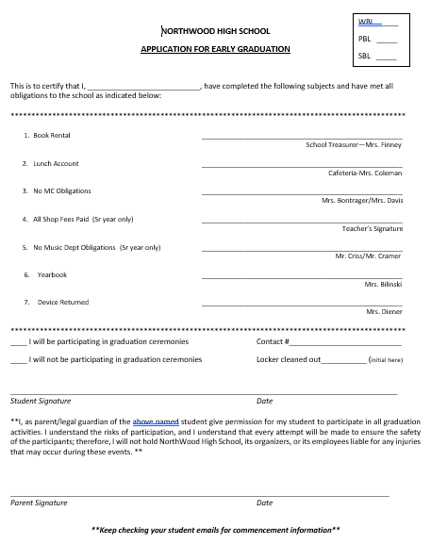
Graduation Applications
Pick up – Mrs. Slone (801), Mrs. Wise(office), or guidance office.
Starts Monday, May 19th
Return to Guidance
Wednesday, May 28th (3PM)
May not obtain signatures during class time. Only before or after school and homeroom
All Fines need to be paid
Must be completed in order to participate in commencement!
Early grads have already completed this
Notes:
JM

Slide 14
NWHS Awards Night
Thursday, June 5th – 7:00 P.M.
The Auditorium
Meet in the band room at 6:15PM
Recognition and reflection—honoring your high school careers and achievements
Formal Dress Expectations Apply. See handout.
Attendance is expected. If you cannot attend, please email either Mrs. Slone or Mrs. Wise
Notes:
EP
Formal attire-good idea to wear your nice graduation outfit for the awards night so everyone can see
Wear it to the graduation underneath your gown

Slide 15
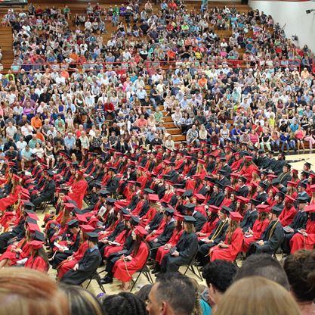
Commencement Practice
Friday, June 6th PROMPTLY at 9:00 AM in the cafeteria
Seating Assignments
Do not need to dress up
MUST ATTEND PRACTICE IN ORDER TO PARTICIPATE!
Notes:
EP

Slide 16
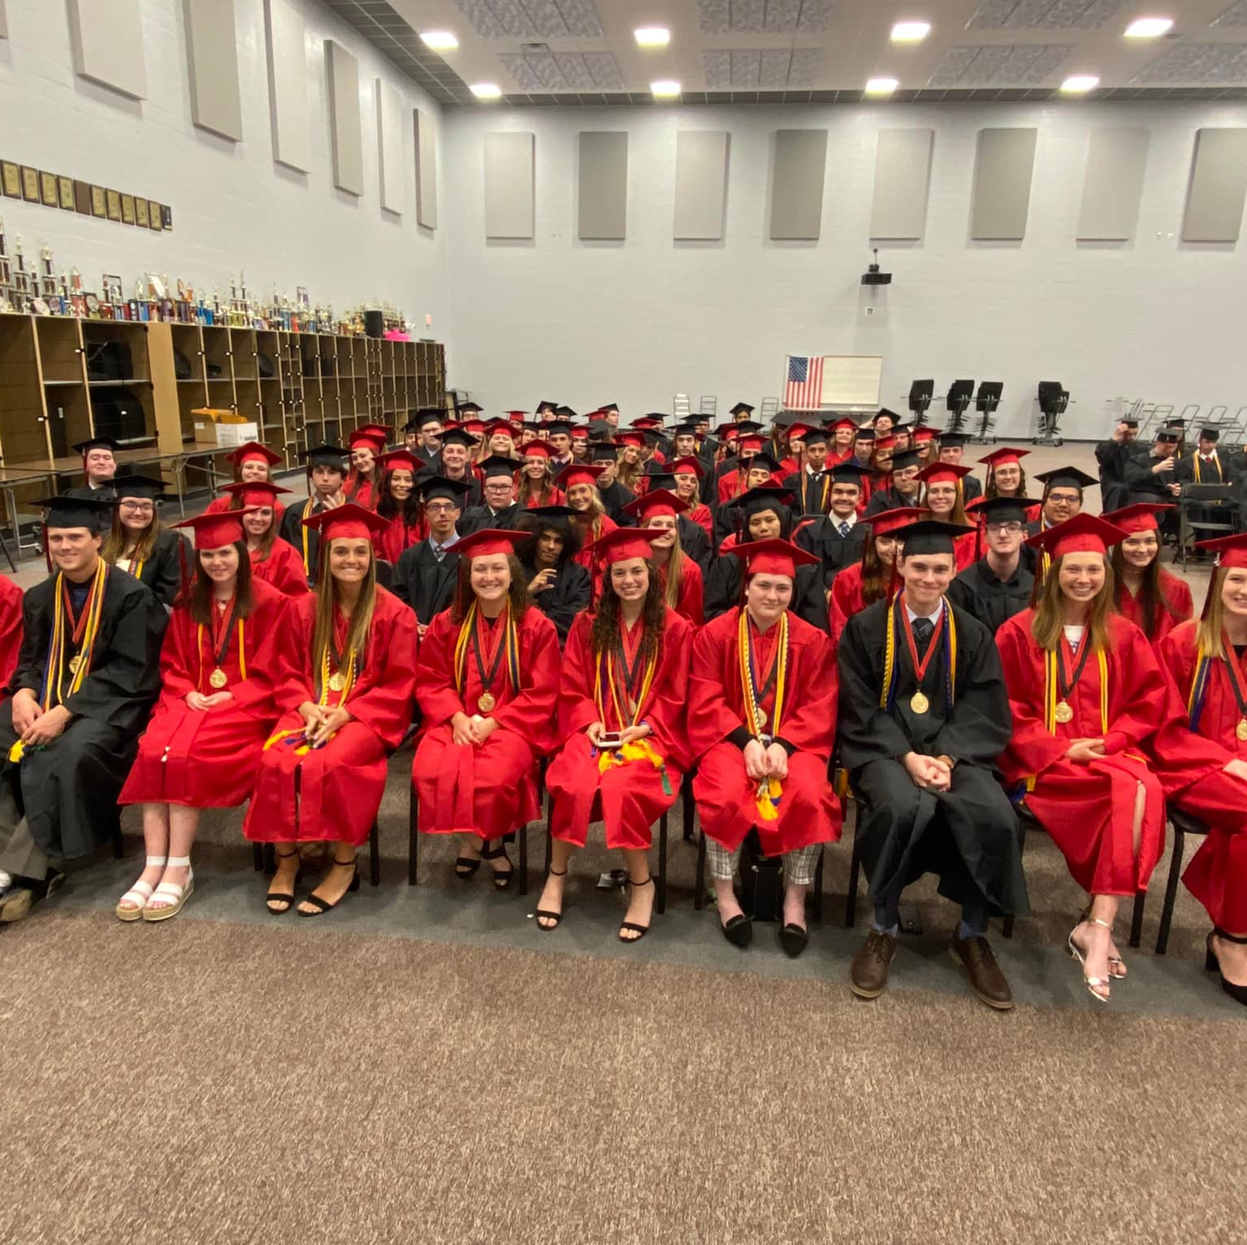
Commencement - June 6th
Doors open to public at 6:00PM
Park on South and use front entrance
Seniors in the band room by 6:15PM
Park on north and use English hallway
Must be in Formal Dress (See earlier slides)
Plan to get a professional headshot while you wait
Diploma Covers in ceremony
Band Room for diploma
Make arrangements beforehand where you’ll meet your family
Broadcast by Mr. Doty on YouTube.
Notes:
EP

Slide 17
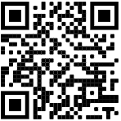
Commencement Video
We want to include pictures from grades 9-12 that include every graduate.
Must be group pictures
Keep it to only seniors
We have your senior yearbook photo.
Pictures must be digital and emailed to: nwhsgraduationvideo@gmail.com
Use this hashtag and some may be pulled from social media: #nwhs2025
Deadline: Monday, May 19th
Notes:
EP

Slide 18
Class Representatives
It is time to select who best exemplifies the ideals and the motto of the Senior Class.
Select 1 female and 1 male student
A representative that values every moment at NWHS.
Someone who is involved with the activities and demonstrate school spirit.
They work to make others better - the school, the staff, the building, the opportunities, and their classmates.
Voting Starts Today!
“Sometimes you will never know the value of a moment until it becomes a memory.” -Dr. Suess
Notes:
EP

